Slide 2
What we do
Use-case
As a customer,
I want to receive money for my lost time
When my flight is delayed by more than one hour

Slide 3
Concurrence comparison
Fizzy.axa
Blockchain-based
Pays @ 2h late
Mobi UFI
No blockchain
Pays @ 1h late
Signin @ -15 days
Signin @ -1 hour
VS

Slide 4
Architecture

Slide 5
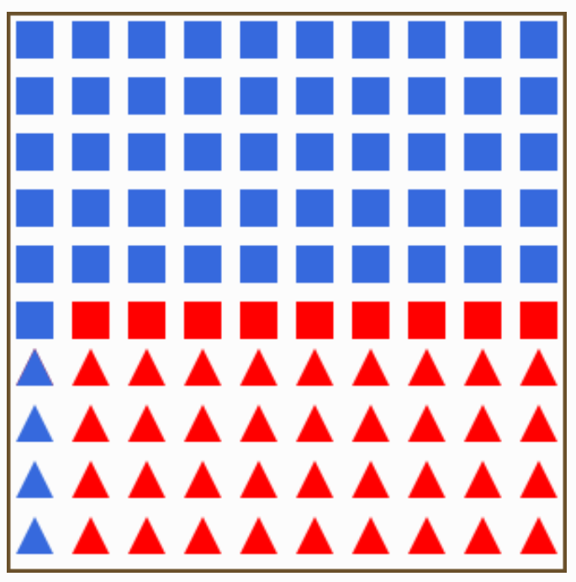
Logique Bayésienne
Rouge=retard>1h P(r<1h)=55%
Bleu = retard <1h P(r>1h)=45%
Carré=Swiss P(Swiss)=60%
Triangle=Easyjet P(Easyjet)=40%
Intuitivement: P(r>1h|Easyjet)=36/40=90%
Bayes: P(r>1h|Easyjet)=P(Easyjet|r>1h)*P(r>1h)/P(Easyjet)) =36/45 * 45 / 40 = 36/40 = 90%

Slide 6
Logique Bayésienne multivariée
Rouge=retard>1h P(r<1h)=55%
Bleu = retard <1h P(r>1h)=45%
Carré=Swiss P(Swiss)=60%
Triangle=Easyjet P(Easyjet)=40%
Fond blanc = départ le matin P(matin)=70%
Fond bleu = départ l’après-midi P(après-midi)=30%
Intuitivement: P(r>1h|Easyjet, matin)=24/28=86%
Bayes: P(r>1h|Easyjet, matin) =
P(Easyjet, matin|r>1h)*P(r>1h)/P(Easyjet, matin)=24/45 * 45/28=24/28=86%

Slide 7
Global flight delay facts
TODO : texte de pascal

Slide 8
Our Probabilistic Model
Parameters: company, day of week, hour of day
Late = at least one hour delay

Slide 9
Bayesian delay probability function
f(company, day of week, hour of day) → probability of being late
Dataset: flights arriving to Geneva airport from 21.05.2018 to today
$$P\left(delay>1h \right|company, dayOfWeek, hourOfDay)=\frac{P\left(delay>1h \right|company, dayOfWeek, hourOfDay)∙P(delay>1h)}{P(company, dayOfWeek, hourOfDay)}$$
90% of the flights will have a delay probability lower than 30%

Slide 10
Cost function
C(delay(..), insuredAmount, K, m1, m2) → premium amount
Pay-as-you-fly, no solidarity between subscribers
$$cost=insuredAmount∙\left(delayProbability∙K+m_{1}\right)+m_{2}$$
Ultimate | Medium | Basic
8’000 | 2’000 | 500
Insured amount
K = 1.1
m₁ = 0.1
m₂ = 5
Flight is not late
Risk is too high so cannot be insured

Slide 11
Next steps
Cost function proportional to number of insured passengers per flight
Simulation of real activity to proove business model robustness

